Slide 1
Enumerating Longest Increasing Subsequences and Patience Sorting
Sergei Bespamyatnikh, Michael Segal,
Department of Computer Science, University of British Columbia, Vancouver, BC, Canada,
Information Processing Letters 76, 2000, pp.7~11.
Presenter: Zhi-Cheng Shen
Date: Apr.11, 2023

Slide 2
Abstract
In this paper we present three algorithms that solve three combinatorial optimization problems related to each other. One of them is the patience sorting game, invented as a practical method of sorting real decks of cards. The second problem is computing the longest monotone increasing subsequence of the given sequence of n positive integers in the range 1,...,n. The third problem is to enumerate all the longest monotone increasing subsequences of the given permutation.

Slide 3
Van Emde Boas Tree
Maintain the sorted list of integers in the range 1,...,n in O(loglogn) time per insertion and deletion.

Slide 4
Van Emde Boas Tree
The data structure T allows the following list
operations:
• insert(i)—insert the number i into S,
• delete(i)—delete the number i from S,
• next(i)—get the successor of i in S, if it does
not exist return nil.
• prev(i)—get the predecessor of i in S, if it does
not exist return nil.

Slide 5
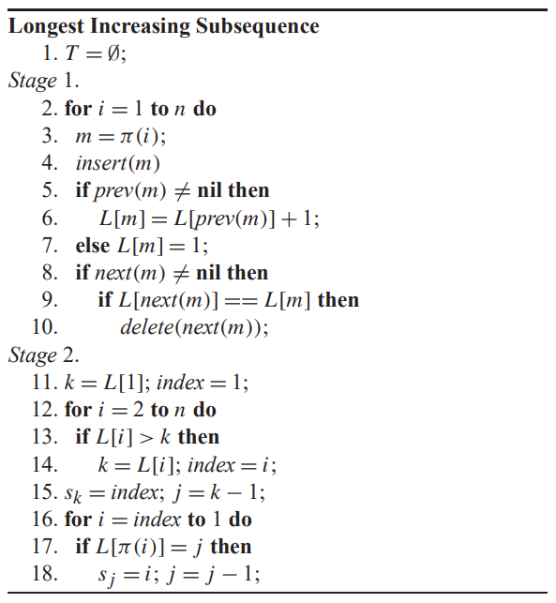
Longest Increasing Subsequence
Ex: 1, 4, 3, 8, 6, 2 lis[]:1, 3, 6
L:
T:
Time Complexity: O(nloglogn)
個人認為第9行code可省略，
第13行應該改成>=才可做後續演算法

Slide 6
Observation
Consider the indices i₁ < i₂ < ··· <i_{m}, such that L[i₁] = L[i₂]=···= L[i_{m}]. Then, the sequence {π(i₁), π(i₂), . . . , π(i_{m})} is decreasing.
Ex: 1, 4, 3, 8, 6, 2
L: 1, 2, 2, 3, 3, 2
T: 1, 2, 6
{4, 3, 2}, {8, 6}

Slide 7
Reporting All LIS
Ex: 1, 4, 3, 8, 6, 2
L: 1, 2, 2, 3, 3, 2
T: 1, 2, 6
left1(6) = 指向8的index
Left2(6) = 指向3的index

Slide 8
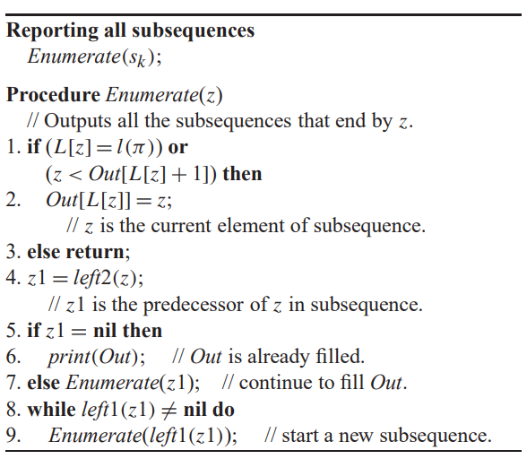
Reporting All LIS
Ex: 1, 4, 3, 8, 6, 2
L: 1, 2, 2, 3, 3, 2
T: 1, 2, 6
LIS:{1, 3, 6}, {1, 4, 6}, {1, 3, 8}
, {1, 4, 8}
S_{k}指的是上一個演算法算出的S_{k}

Slide 9
Time Complexity
Time Complexity: O(n + K*l(π))//K為lis的數量，l(π)為lis的長度
Our observation above provides an efficient way to find these values using pointers left1 and left2, cutting the search at line 1.

Slide 10
Patience Sorting
Ex: 1, 4, 3, 8, 6, 2
Time Complexity: O(nlogn)

Slide 11
Patience Sorting
S: Van Emde Boas tree that represents the list of top cards.
card[i] = 在同一堆牌中i在誰的上面

Slide 12
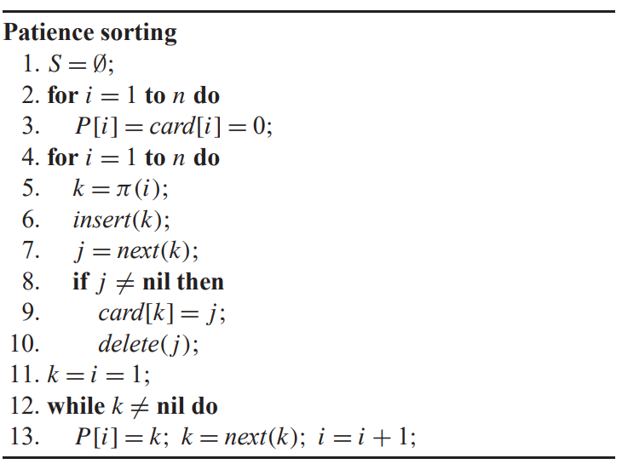
Patience Sorting
Ex: 1, 4, 3, 8, 6, 2
K:1 4 3 8 6 2
S[]:
j: 4 8 3
card[3] = 4 PS: 1 4 8
card[6] = 8 3 6
card[2] = 3 2
Time Complexity: O(nloglogn)
第11行k應該要改成第一個元素

Slide 13
Thanks~

